Slide 1
MATH2010 Probability and STATISTICS
Le DUY DUNG
College of Engineering and Computer Science

Slide 2
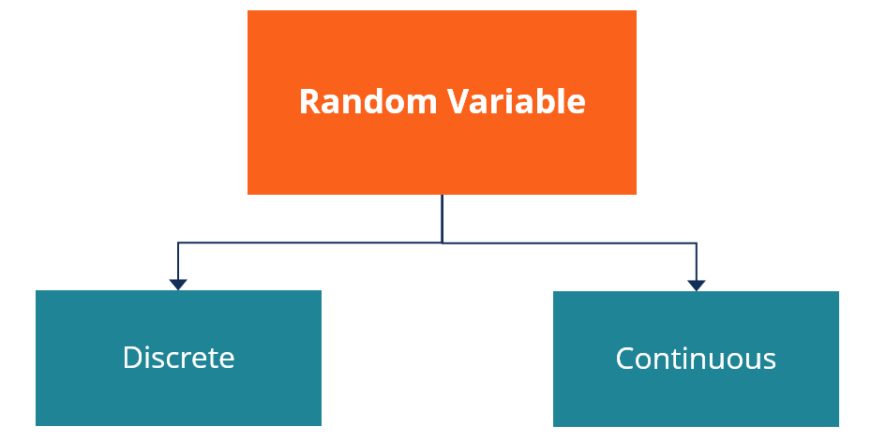
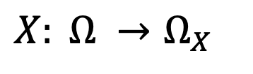

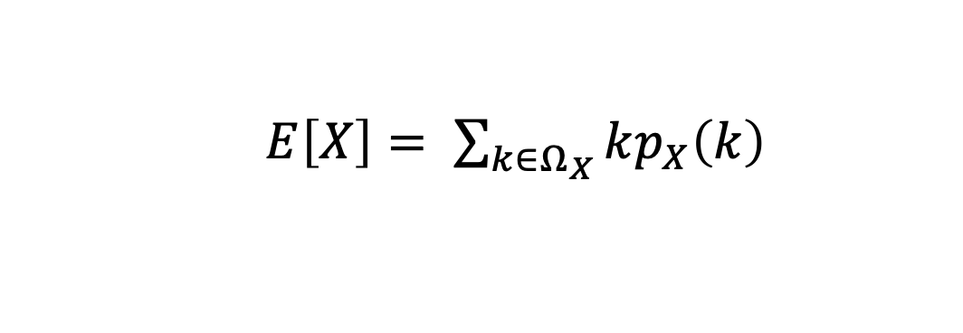
From Lecture 5
$$X: Ω →Ω_{X}$$
Expectation
$E\left[X\right]= \sum_{k∈Ω_{X}}{kp_{X}\left(k\right)}$
Variance
$$Var\left[X\right]=E\left[{\left(X −E\left[X\right]\right)}^{2}\right] =E[X^{2}]−E{\left[X\right]}^{2}$$

Slide 3
Learning goals
Indepence of Random Variables
Know the Bernoulli, binomial, and geometric distributions

Slide 4
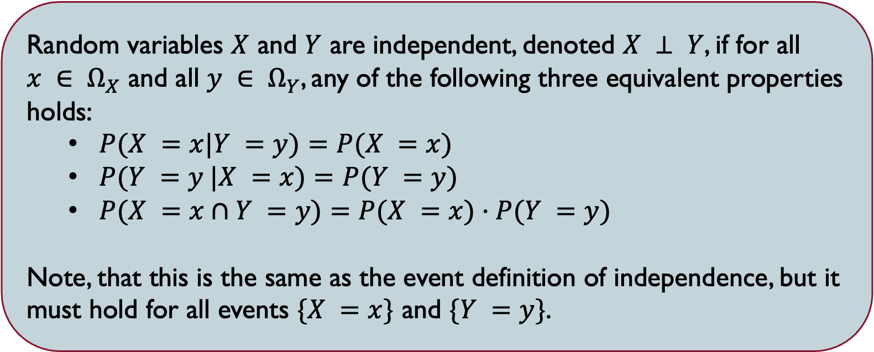
Independence of random variables
Random variables $X$ and $Y$ are independent, denoted $X ⊥ Y$, if for all $x ∈ Ω_{X}$ and all $y ∈ Ω_{Y}$, any of the following three equivalent properties holds:
$P(X =x|Y =y)=P(X =x)$
$P(Y =y |X =x)=P(Y =y)$
$P(X =x∩Y =y)=P(X =x)·P(Y =y)$
Note, that this is the same as the event definition of independence, but it must hold for all events $\{X =x\}$ and $\{Y =y\}$.

Slide 5
e.g. If a coin is tossed once, what is the probability that
it comes up heads?
Bernoulli

Slide 6
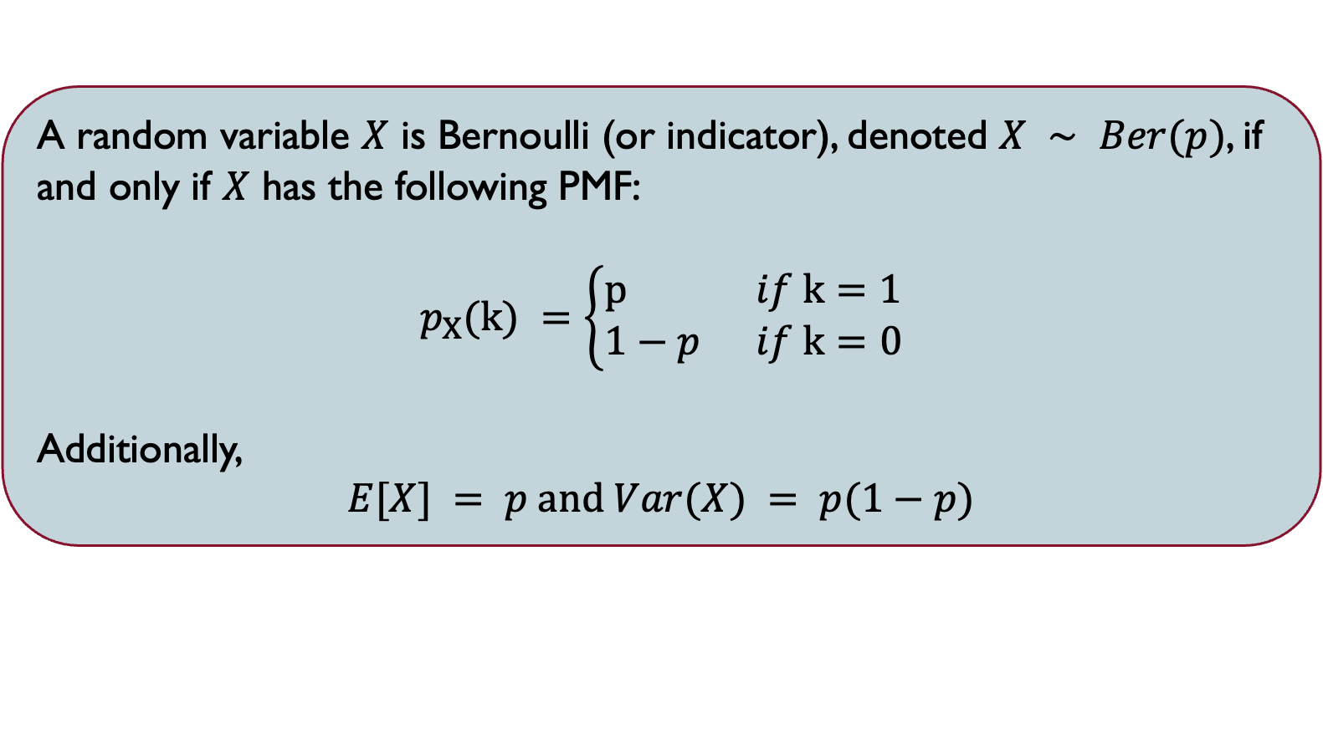
Bernoulli random variable
A random variable $X$ is Bernoulli (or indicator), denoted $X ∼ Ber(p)$, if and only if $X$ has the following PMF:
$$p_{X}(k) =\left\{\begin{aligned}p if k=1 \\ 1−p if k=0\end{aligned}\right.$$
Additionally,
$$E[X] = p and Var(X) = p(1−p)$$

Slide 7
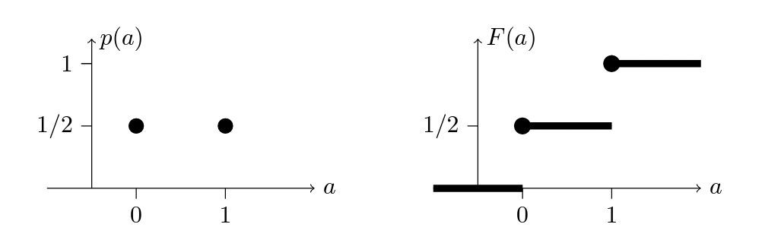
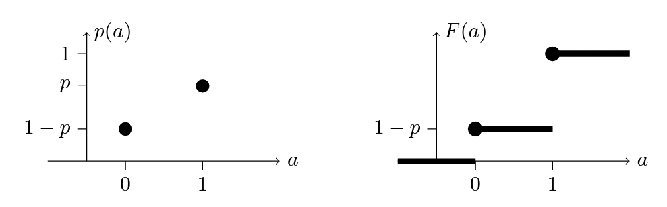






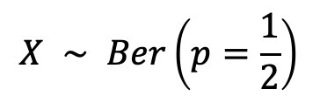

Bernoulli random variable
$$p_{X}(k)$$
$$F_{X}(k)$$
$$X ∼ Ber\left(p=\frac{1}{2}\right)$$
$$Ω_{X}=\{0, 1\}$$
PMF
CDF
$$p_{X}(k)$$
$$F_{X}(k)$$
$$X ∼ Ber\left(p\right)$$
$$Ω_{X}=\{0, 1\}$$

Slide 8
Bernoulli Trail
A Bernoulli trail is a random experiment with exactly two possible outcomes, “success” and “failure”.
The probability of “success” is the same everytime the experiment is conducted.
Example: usually can be framed as some "yes or no" question
Is the top card of a shuffled deck an ace?
Was the newborn child a girl?
Independent repeated trials of an experiment with exactly two possible outcomes are called Bernoulli trials.

Slide 9
Independent Bernoulli Trails
Binomial
If a coin is tossed 20 times, what is the probability that heads comes up exactly 14 times?

Slide 10
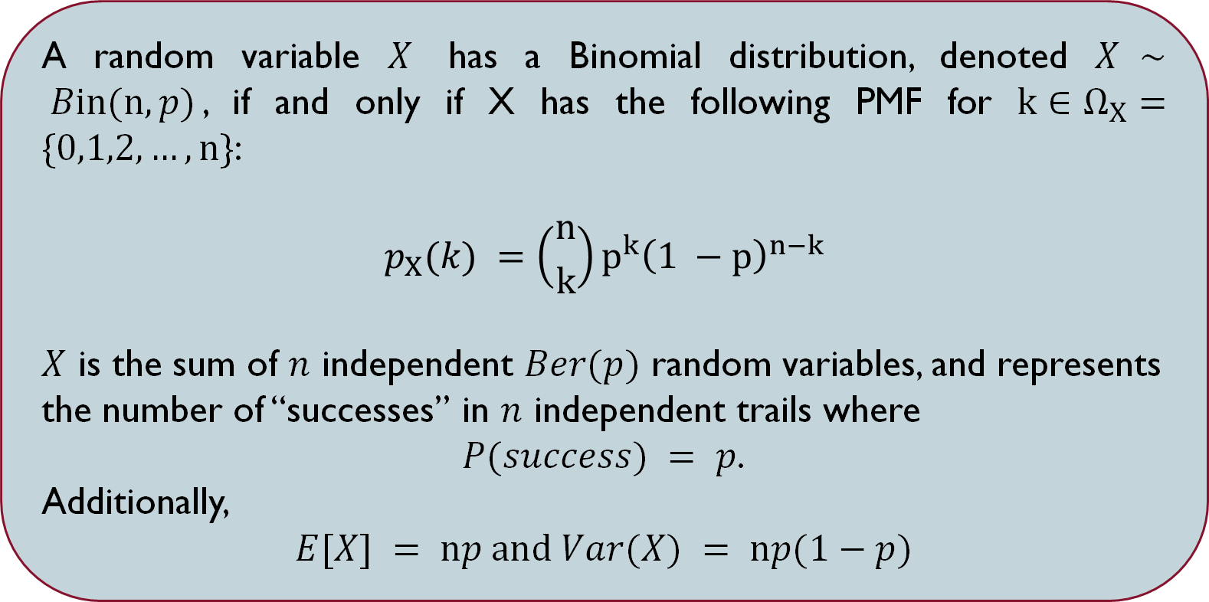
Binomial random variable
A random variable $X$ has a Binomial distribution, denoted $X ∼ Bin(n,p)$, if and only if X has the following PMF for $k∈Ω_{X}=\{0,1,2,…,n\}$:
$$p_{X}(k) =\left({n \atop k}\right)p^{k}{\left(1 −p\right)}^{n−k}$$
$X$ is the sum of $n$ independent $Ber(p)$ random variables, and represents the number of “successes” in $n$ independent trails where
$P(success) = p$.
Additionally,
$$E[X] = np and Var(X) = np(1−p)$$

Slide 11
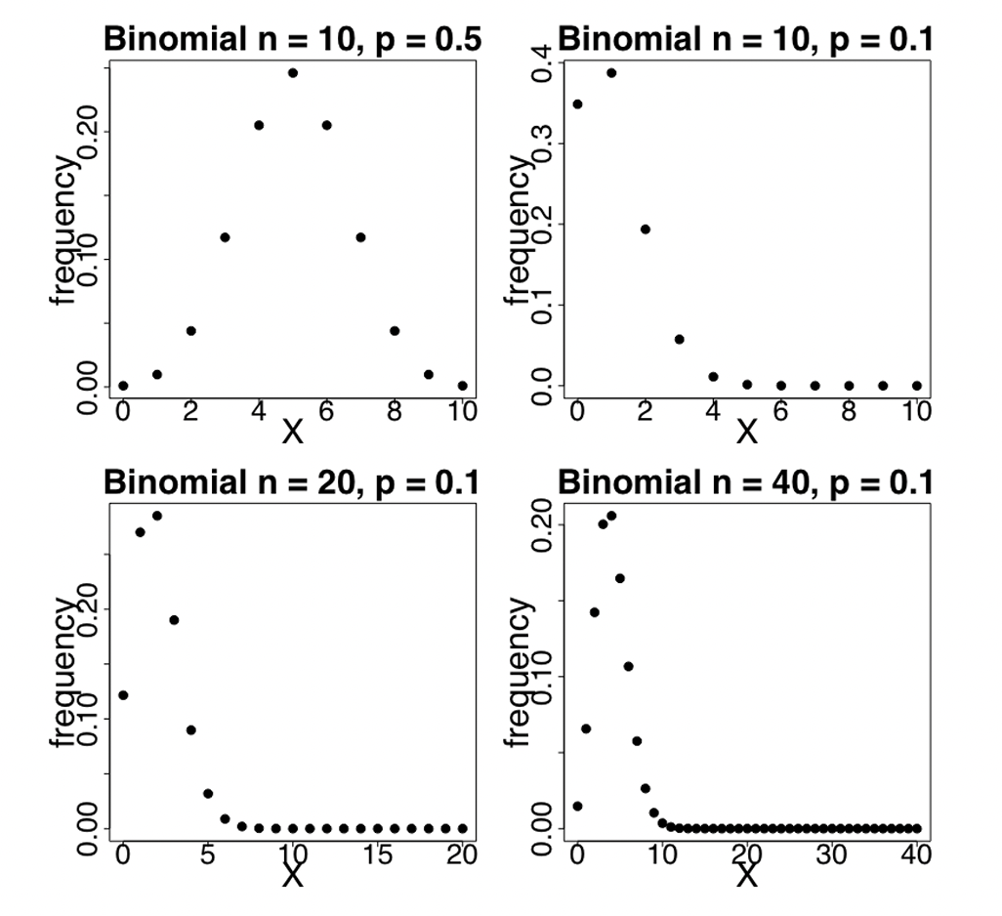

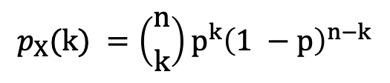







Binomial random variable
$$p_{x}(k)$$
$$p_{x}(k)$$
$$k$$
$$k$$
$$p_{X}(k) =\left({n \atop k}\right)p^{k}{\left(1 −p\right)}^{n−k}$$
$$p_{x}(k)$$
$$p_{x}(k)$$
$$k$$
$$k$$

Slide 12
Binomial random variable
A factory produces 100 cars per day, but a car is defective with probability 0.02. What’s the probability that the factory produces 2 or more defective cars on a given day?

Slide 13
Independent Bernoulli Trails
Binomial
Geometric
If a coin is repeatly tossed, what is the probability that the first time heads comes up occurs on the 8th toss?
If a coin is tossed 20 times, what is the probability that heads comes up exactly 14 times?

Slide 14
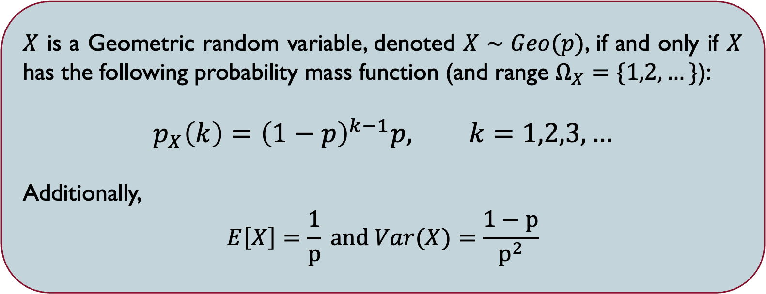
GEOMETRIC RANDOM VARIABLE
$X$ is a Geometric random variable, denoted $X∼Geo(p)$, if and only if $X$ has the following probability mass function (and range $Ω_{X}=\{1,2,…\}$):
$$p_{X}\left(k\right)={\left(1−p\right)}^{k−1}p, k=1,2,3,…$$
Additionally,
$$E\left[X\right]=\frac{1}{p} and Var(X)=\frac{1−p}{p^{2}}$$

Slide 15
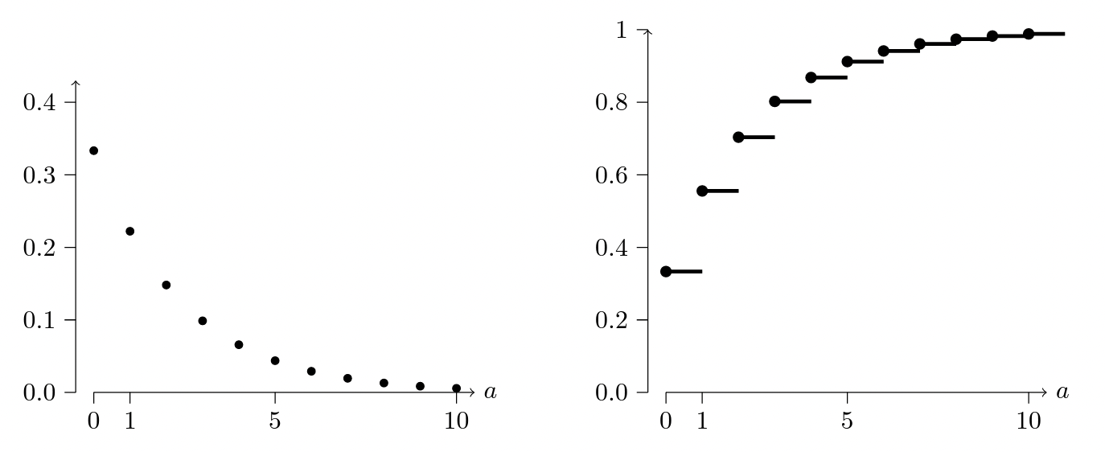

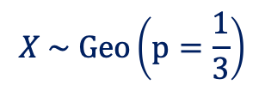
GEOMETRIC RANDOM VARIABLE
PMF
CDF
$$k$$
$$k$$
$$X \sim Geo\left(p=\frac{1}{3}\right)$$

Slide 16

GEOMETRIC RANDOM VARIABLE
Let’s say you buy lottery tickets everyday, and the probability you win on a given day is 0.01, independently of other days. What is the probability that after a year ( 365 days), you still haven’t won? What is the expected number of days until you win your first lottery?

Slide 17
Independent Bernoulli Trails
Binomial
Geometric
Negative
Binomial
If a coin is tossed 20 times, what is the probability that heads comes up exactly 14 times?
If a coin is repeatly tossed, what is the probability that the first time heads comes up occurs on the 8th toss?
If a coin is repeatly tossed, what is the probability that the third time heads appears occurs on the 9th toss?

Slide 18
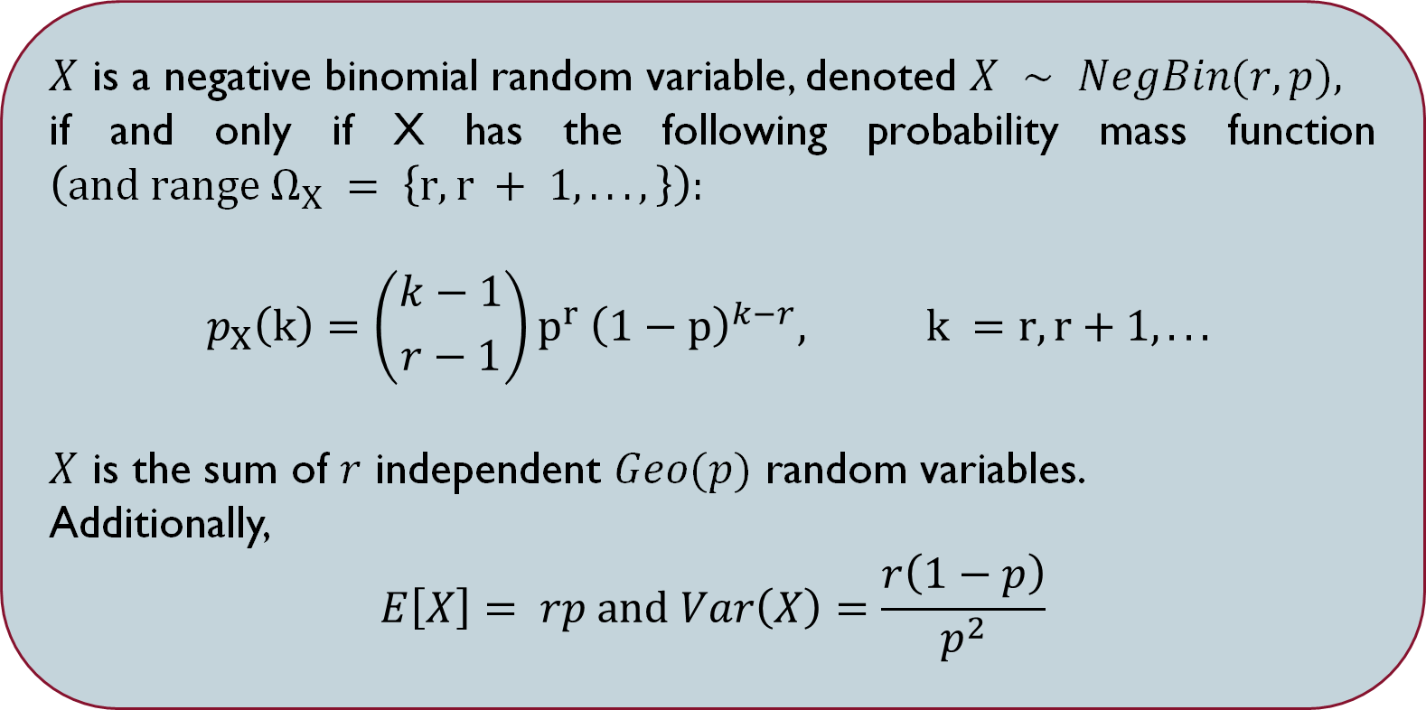
Negative Binomial RANDOM VARIABLE
$X$ is a negative binomial random variable, denoted $X ∼ NegBin(r,p),$
if and only if X has the following probability mass function $\left(and range Ω_{X} = \left\{r,r + 1,...,\right\}\right):$
$$p_{X}\left(k\right)=\left({k−1 \atop r−1}\right)p^{r} {\left(1−p\right)}^{k−r}, k =r,r+1,...$$
$X$ is the sum of $r$ independent $Geo(p)$ random variables.
Additionally,
$$E\left[X\right]= rp and Var\left(X\right)=\frac{r\left(1−p\right)}{p^{2}}$$

Slide 19
Negative Binomial RANDOM VARIABLE
A person conducting telephone surveys must get 3 more completed surveys before their job is finished.
On each randomly dialed number, there is a 9% chance of reaching an adult who will complete the survey.
What is the probability the 3rd completed survey occurs on the 10th call?

Slide 20
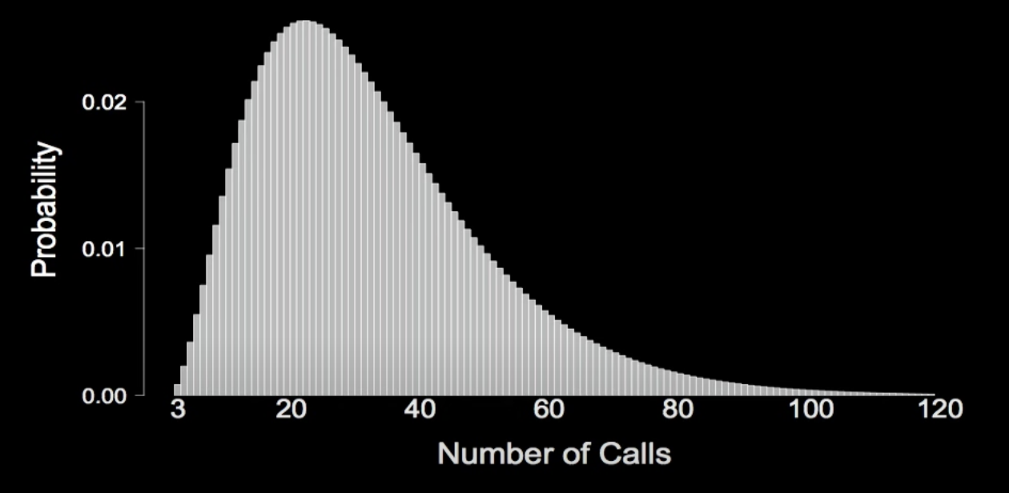
Negative Binomial RANDOM VARIABLE
A person conducting telephone surveys must get 3 more completed surveys before their job is finished.
On each randomly dialed number, there is a 9% chance of reaching an adult who will complete the survey.
What is the probability the 3rd completed survey occurs on the 10th call?

Slide 21
SUmmary
Independent Bernoulli Trails
Binomial
Geometric
Negative
Binomial
If a coin is tossed 20 times, what is the probability that heads comes up exactly 14 times?
If a coin is repeatly tossed, what is the probability that the first time heads comes up occurs on the 8th toss?
If a coin is repeatly tossed, what is the probability that the third time heads appears occurs on the 9th toss?

